Slide 1
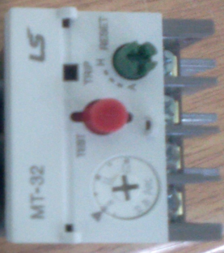
11. Troubleshooting
Hydraulic Pump Error
M7012 – Hydraulic pump overload alarm (Input signal: X01D)
Alarm is generated by overload of electronic contactor EOCR (X012) operation
① Check the wiring condition of hydraulic pump
② Check the wiring and operating condition of Unloading Valve
③ Check the failure of electronic contactor and EOCR
- RESET is only possible by pushing the green RESET button for EOCR reset
2. M7015- Hydraulic pump operation alarm (Input signal: X031)
Alarm is generated by missing the check signal of electronic contactor ON
① Check the failure of electronic contactor (M/C)
② Check the wiring of input signal
3. M7020 –Hydraulic Unloading Valve Off Timeover
Alarm is generated when the hydraulic Unloading Valve operates over the settled time
① Check the PLC timer T41 settling time (Default: 50 sec)
② Check the operation condition of hydraulic motor
③ Check the leakage and pipe condition of hydraulic pipe
④ Check the Unloading Valve condition and wiring

Slide 2
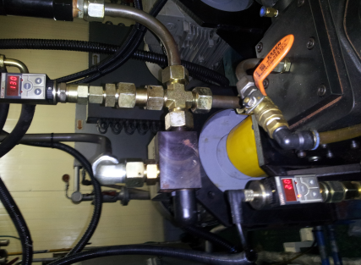
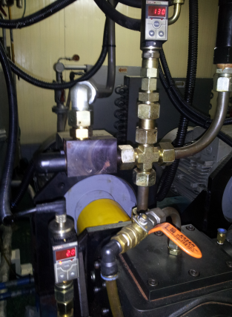
- POL +ISO Pump alarm
M7010- POL pump overload alarm(Input signal : X0IF) / M7011- ISO pump overload alarm
(Input signal : X01E)
Alarm is generated when the hydraulic electronic contactor EOCR (X010/X011) is operated by overload
① Check the operating condition of Metering pump and wiring condition
② Check the failure of electronic contactor (M/C) and EOCR
2. M7014- POL pump operation alarm (Input signal : X033) / M7013- ISO pump operation alarm
(Input signal : X032)
Alarm is generated by missing the check signal of electronic contactor ON (X007/X008)
① Check the failure of electronic contactor (M/C)
② Check the wiring of input signal
3. M7075- POLT Tank low pressure alarm (Input signal : X00D) / M7070-ISO Tank low pressure alarm
(Input signal : X00A)
Alarm is generated when the incoming pressure to POL or ISO Tank is lower than settled pressure
① Check the N2 pressure valve operating condition and failure of POL or ISO
② Check the leakage and pipe condition from Tank to Metering Pump
③ Check the failure of pressure gauge
④ Check the wiring condition of pressure gauge
⑤ Check the setting value settled on pressure gauge
4. M7064-POL Head low pressure alarm (Input signal : X00E) / M7067-ISO Head low pressure alarm
(Input signal : X00B)
Alarm is generated when the circulation pressure of POL of ISO is lower than settled pressure
in high pressure circulation
①Check the Metering pump operating condition of POL or ISO
② Check the leakage and pipe condition of pipe
③ Check the failure of pressure gauge
④ Check the wiring condition of pressure gauge
⑤ Check the setting value settled on pressure gauge

Slide 3
5. M7065- POL Head High pressure alarm(Input signal: X00F) / M7068- ISO Head High pressure alarm
(Input signal : X00C)
Alarm is generated when the circulation pressure of POL or ISO is higher than settled pressure in
low/high pressure circulation
① Check the Metering pump operating condition of POL or ISO
② Check the leakage of pipe and pipe condition
③ Check the failure of pressure gauge
④ Check the wiring condition of pressure gauge
⑤ Check the settled value of pressure gauge
6. M7056- ISO+POL Pump Off alarm on injection
Alarm is generated when the ISO+POL Pump off condition during injection
① Check the failure of electrical contactor
② Check the wiring condition of Metering Pump

Slide 4
- Injection Head Error
1. M7024 – Cleaning Piston Up position Alarm (Input signal: X014)
Alarm is generated when the Cleaning Piston position is not placed on Up position for settled time
(PLC timer : T82) after Ejector up operation command
① Check the hydraulic pressure condition
② Check the leakage of hydraulic pipe and pipe condition
③ Check the ejector operation valve and wiring condition
④ Check the failure of ejector Up check sensor and wiring condition
2. M7025 - Cleaning Piston Down position Alarm (Input signal: X015)
Alarm is generated when the Cleaning Piston position is not placed on Down position for settled time
(PLC timer : T83) after Ejector down operation command
① Check the hydraulic pressure condition
② Check the leakage of hydraulic pipe and pipe condition
③ Check the ejector operation valve and wiring condition
④ Check the failure of ejector Down check sensor and wiring condition
3. M7040 – Control Piston Close position alarm (Input signal : X016)
Alarm is generated when the Control piston position is not placed on reverse position for settled time
(PLC timer : T80) after Control piston Close operation command
① Check the hydraulic pressure condition
② Check the leakage of hydraulic pipe and pipe condition
③ Check the Throttle operation valve and wiring condition
④ Check the failure of Control piston reverse check sensor and wiring condition
4. M7041 – Control Piston Open position alarm (Input signal : X016)
Alarm is generated when the Control piston position is not placed on forward position for settled time
(PLC timer : T81) after Control piston Open operation command
① Check the hydraulic pressure condition
② Check the leakage of hydraulic pipe and pipe condition
③ Check the Throttle operation valve and wiring condition
④ Check the failure of Control piston forward check sensor and wiring condition

Slide 5
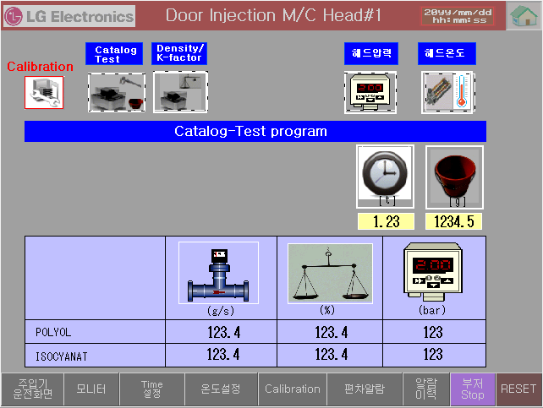
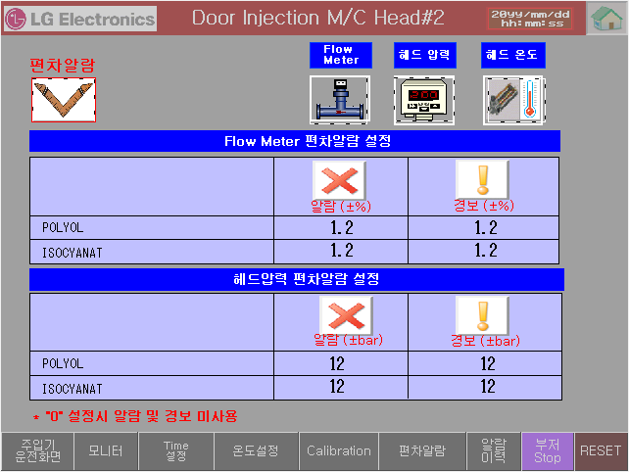
5. M7090~M7097 – POL+ISO Head pressure alarm/ warning
Alarm is generated when the settled pressure deviation alarm is under the standard pressure
Ex) Standard pressure -120bar Settled deviation alarm -5bar
* 120-5 =115bar *120+5= 125bar
Under the 115bar: Low alarm generation, Upper the 125bar: High alarm generation
① Check the settled deviation alarm value
② Check the failure of pressure sensor on head, and wiring condition
③ Check the operation condition of PLC AD681 card
Flow rate deviation alarm setting
Reference pressure
Pressure deviation alarm setting
6. M7100~M7107 – POL+ISO Head pressure alarm/ warning
Alarm is generated when the settled temperature deviation alarm is under the standard temperature
Ex) Standard temperature -25 deg Settled deviation alarm -5deg
* 25-5 =20deg *25+5= 30deg
Under the 20 deg: Low alarm generation, Upper the 30 deg: High alarm generation
① Check the settled deviation alarm value
② Check the failure of temperature sensor on head, and wiring condition
③ Check the operation condition of PLC AD64RD card

Slide 6
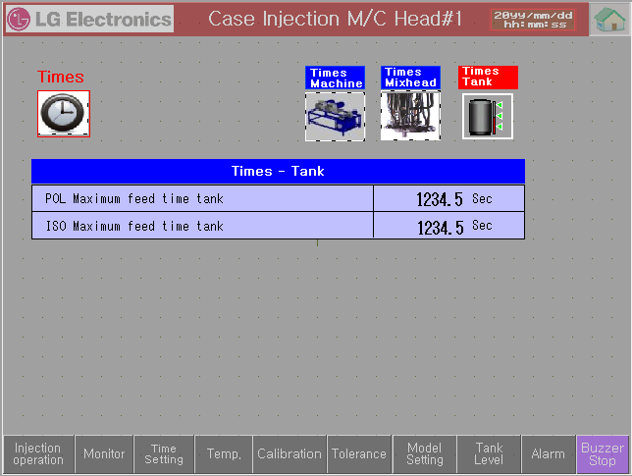
- Tank Error
1. M7012– POL Tank Feeder Time over (T600) / M7013– ISO Tank Feeder Time over (T601)
When liquid is not supplied to settled Level within settled time, alarm occurs.
① Check the Main Air.
② Check the operating condition of Supply Valve.
③ Check the wiring condition of Supply Valve.
Feeder Time setting
2. M7120 – POL Tank agitator overload alarm (Input signal: X01B)
Alarm is generated by overload of electronic contactor EOCR (X01B) operation
① Check the wiring condition of agitator
② Check the failure of electronic contactor and EOCR
3. M7121 – ISO Tank agitator overload alarm (Input signal: X01C)
Alarm is generated by overload of electronic contactor EOCR (X01C) operation
① Check the wiring condition of agitator
② Check the failure of electronic contactor and EOCR

Slide 7
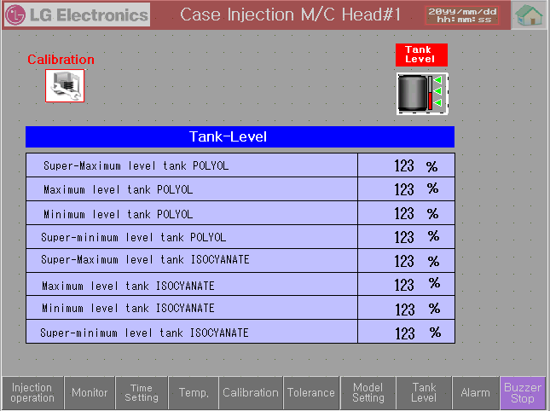
4. M7030– POL Tank Level Super Min Fault / M7031– ISO Tank Level Super Min Fault
When the Tank Level is lower than settled(Super Max) Level, alarm occurs.
① Check the Main Air.
② Check the operating condition of Supply Valve.
③ Check the wiring condition of Supply Valve.
④ Check the operating & wiring condition of Level Sensor.
5. M7035– POL Tank Level Super Max Fault / M7036– ISO Tank Level Super Max Fault
When the Tank Level is higher than settled(Super Max) Level, alarm occurs.
① Check the Main Air.
② Check the operating condition of Supply Valve.
③ Check the wiring condition of Supply Valve.
④ Check the operating & wiring condition of Level Sensor.

